Slide 1
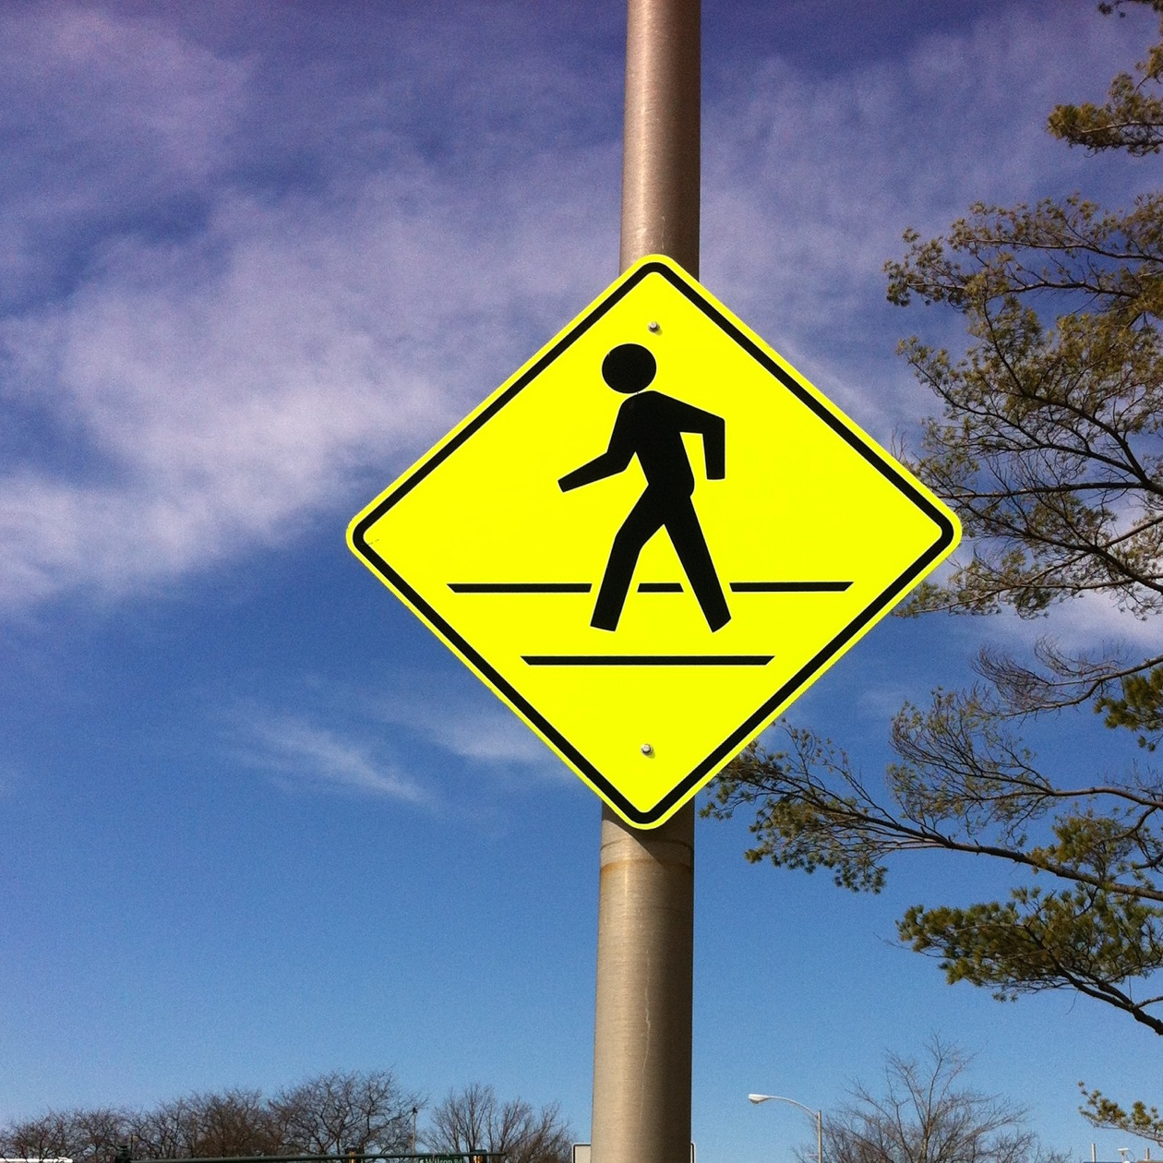
Do People Enjoy Thinking?
Intentional Reverie is Real but Rare
Erin C. Westgate, Timothy D. Wilson University of Virginia
Do People Enjoy Thinking?
Intentional reverie is the experience of intended enjoyable internal thought in the absence of external stimulation
Although possibly beneficial, it appears to be surprisingly difficult. Experimental studies (Wilson et al., 2014) suggest that many people do not enjoy intentional thinking and may prefer even negative external stimulation (e.g., electric shock) to being alone with their thoughts
It is unclear whether and to what extent people engage in intentional reverie in everyday life, and whether people enjoy entertaining themselves with their thoughts if they choose to do so.
The present study used experience sampling via cell phone to sample participants’ thoughts over a 7-day period, gathering ratings of thought category, attention, intentionality, desirability, and mood
Questions
Do people entertain themselves with their thoughts
(i.e.., experience intentional reverie) in everyday life?
Is intentional reverie pleasant?
In what settings is intentional reverie most common?
Intentional Reverie
Thought Settings
Methods
Participants
171 undergraduates (119 female, 50 male, 2 declined to
answer)
Ages 18-22(Mean age = 18.83, SD = 1.09).
Conclusions
Frequency
Overall, intentional reverie was reported but appears to be infrequent (7.9%). A minority of students (29%) reported no instances of intentional reverie.
Mood and Valence
Intentional reverie was mildly positive in valence (M = 4.72, 95% CI: 4.59, 4.85 ).
Intentional reverie was associated with mildly positive moods , but spontaneous reverie was even more enjoyable
Thought Settings
Intentional reverie was most common during personal grooming, shopping, playing sports, outdoor recreation, religious services, and during transit .
Although intentional reverie does occur, it appears to be infreuqent and less enjoyable than spontaneous reverie. It may be particularly challenging to initiate and sustain thoughts with the goal of entertaining yourself with your own mind.
Procedure
Training Phase (In the lab)
Received instruction in thought categories and completed verbal quiz and practice session on smartphone
Completed individual difference measures
Thought Sampling (7 days, via smartphone)
7 days, 4 times a day between 10am and 10pm
Categorized thoughts into one (or more) of 17 categories and answered eight questions about their thoughts, including intentionality, desirability, focus of attention (internal vs external), valence, mood, and current activity
Mood
Intentional reverie (internally focused intended desired thought) was associated with neutral to mildly positive moods. However, spontaneous reverie (and desired external thoughts) were associated with even more positive moods, b = .01 , t(2605.23) = 2.09, p = .036.
People were happier when their attention was directed towards the outside world rather than on their own internal thoughts, b = .09, t(2637.11) = 3.54, p < .001.
Future-oriented thought was associated with more positive moods, b = .10, t(2688.27) = 4.16, p < .001.
People reported the most positive moods when engaged in socializing, relaxing, or leisure, b = .22, t(2640.28) = -4.09, p < .001
Analyses
Intentional reverie was defined as checking an internal thought category and focusing attention internally on one’s thoughts, wanting to be having those thoughts, and intending to have those thoughts
Mixed models were used to control for the random effect of participant
Additional details on materials and analysis may be found at https://osf.io/avu7r/
References
Wilson, T.D., Reinhard, D., Westgate, E., Gilbert, D., Ellerbeck, N., Hahn, C., Brown, C., & Shaked, A. (2014). Just Think: The Challenges of the Mind at Play. Science, 345, 75-77.
.
Questions? Contact: Erin Westgate, ecw4za@virginia.edu
Notes:
This poster template is from http://www.swarthmore.edu/NatSci/cpurrin1/posteradvice.htm. It is free, free, free for non-commercial use. If you really like it, I’m always thrilled to get postcards from wherever you happen to be presenting your poster. -- Colin Purrington, Department of Biology, Swarthmore College, Swarthmore, PA 19081, USA. cpurrin1@swarthmore.edu
1

